Slide 1
"GOD’S ANOINTED WARRIORS IN THE LAST DAYS” Hosted By DR. DONALD BELL --- MAJOR, USMC, RET.
UNVEILING MYSTERIES IN THE
“BOOK OF REVELATION”
In Order To
BECOME A WARRIOR FOR CHRIST
DURING THE COMING TRIBULATIONS

Slide 2
SESSION #10
MYSTERY BABYLON:
THE CAPITAL OF
POWER, WEALTH, & IDOLATRY
(Revelation 17 - 18)
Based upon the Book:
“GOD’S ANOINTED WARRIORS”
by
DR. DONALD BELL ------- MAJOR, USMC, RET.
Notes:
2

Slide 3
A PROSTITUTE RIDES “THE BEAST”
A great prostitute who is seated on many waters -
The kings of the earth have committed sexual immorality -
With the wine of whose sexuality immorality, the dwellers on the earth have become drunk.
Revelation 17: 1-6

Slide 4
A PROSTITUTE RIDES “THE BEAST”
A woman sitting on a scarlet beast that was full of blasphemous names, and it had seven heads & ten horns.
Babylon the great, mother of prostitutes and of earth’s abominations.
The woman was drunk with the blood of the saints, the blood of the martyrs of Jesus.
Revelation 17: 1-6

Slide 5
A PROSTITUTE RIDES “THE BEAST”
Our Lord Commands Us To:
“Come out her, my people, lest you share in her plagues;
for her sins are heaped high as heaven, and
God has remembered her iniquities.
Revelation 18:4-5

Slide 6
A PROSTITUTE RIDES “THE BEAST”
Our Lord Commands Us To:
For this reason her plagues will come in a single day,
death and mourning and famine;
and she will be burned up with fire; for
mighty is the Lord God who has judged her.
Revelation 18: 8

Slide 7
MYSTERY BABYLON PRECEDES THE “ANTICHRIST”
Harlot Woman & the Beast
And the ten horns that you saw are ten kings who have not yet received royal power, but they are to receive authority as kings for one hour, together with the beast. Rev. 17:12
The Beast – Antichrist
And I saw a beast coming out of the sea. He had ten horns and seven heads, with ten crowns on his horns, and on each head a blasphemous name. Rev. 13:1

Slide 8
SEVEN HEADS REPRESENT “7 MOUNTAINS & 7 KINGS”
The seven heads are seven mountains on which the woman is seated;
They are also seven kings, five of whom have fallen, one is, the other has not yet come,
and when he does come he must remain only a little while.
Revelation 17:9-10

Slide 9
MOUNTAINS ARE SYMBOLIC OF “MIGHTY EMPIRES”
Just as a mountain is visibly manifested high above the normal surface of the earth, ---
these ancient empires were the greatest among all the surrounding nations in the world.
It is probable that this Babylonian woman, who rides on the top of these symbolic mountains, ---
is the controlling influence over all the great empires that have arisen over the centuries.
She is astride the seven-headed beast which reveals that ---
she is the one that steers the direction of the mighty kingdoms of the World.

Slide 10
MYSTERY BABYLON A CONTROLLING INFLUENCE
Babylonian Empire = Head of Gold
All kingdoms that have risen to power are all part of Mystery Babylon.
Babylon is the “head” that controls the affairs of the world and the authority that ----
oppresses the people of God throughout all the ages since the beginning of time.

Slide 11
MYSTERY BABYLON “A GREAT CITY”
And the woman that you saw is the great city that has dominion over the kings of the earth." REV 17:18
================================
Come, I will show you the Bride, the wife of the Lamb." And he carried me away in the Spirit to a great, high mountain, and showed me the holy city Jerusalem coming down out of heaven from God, having the glory of God, its radiance like a most rare jewel, like a jasper, clear as crystal. REV 21:9-11

Slide 12
MYSTERY BABYLON “A GREAT CITY”
TWO SPIRITUAL CAPITAL CITIES:
Mystery Babylon represents the
Kingdom of the World
She is a prostitute that whores with the world
================================
New Jerusalem represents the
Kingdom of God
She is the Bride of Christ

Slide 13
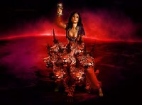
MYSTERY BABYLON “SEATED ON MANY WATERS”
Many believe that Mystery Babylon is representative of the world-cities of today.
These are cities in supposedly Christian nations that have exported evil across the globe.
The city-prostitute who commits fornication with all the nations of the earth and reigns from a city which is the center of world-wide commerce and industry.

Slide 14
MYSTERY BABYLON – UNITING POLITICS - COMMERCIAL - RELIGION
Every mighty world empire has embraced the following three sources of power within society:
Political & Military represented by the “Kings of the Earth.”
Commercialism represented by the “Merchants of the Earth.”
These are the ones who mourn the destruction of Mystery Babylon in Revelation 18.
Idolatrous Religion represented by “Woman who is drunk with the blood of the saints”

Slide 15
THE HARLOT WOMAN & “COMMERCIALISM”
Commercialism = attitude of the heart that can grow into the religion of Money Worship.
Merchants of the earth throughout the centuries have crawled in bed with the prostitute who rides the beast.
They are “profit motivated” not “service motivated.”
The spirit behind “Commercialism” is the love of “Money.”
Money is the greatest of all the idols in our generation
Money is the greatest rival of God for the affections and devotions of mankind.

Slide 16
THE HARLOT WOMAN & “RELIGIOUS POWER”
Both “religion” for its millions of followers seeking security in the afterlife and “commercialism” for its wealth --- are extremely powerful and generally control the affairs of worldly life.
All the injustices that are committed in the commercial and religious segments of society are symbolized by this harlot woman.
Her cup is full of the abominations of an evil worldly kingdom that has ---
persecuted the true people of God since the beginning of time.

Slide 17
THE BEAST = POLITICAL & MILITARY POWER
This seven headed beast that is being guided by the harlot woman represents --
the political and military powers of the world.
They will be viciously dedicated to wiping out the people of Christ from the face of the earth --
which will provide more blood for their rich and beautiful whore.
The coming 7th Kingdom
will be a United
Confederation of Nations

Slide 18
THE BEAST = DAYS OF GREAT TRIBULATION
Matthew 24:21-22
For then there will be great tribulation, such as has not been from the beginning of the world until now, no, and never will be.
And if those days had not been cut short, no human being would be saved.
But for the sake of the elect those days will be cut short.
Endure Great Tribulation
Do not Compromise
Stand in the Presence of the Father & His Son

Slide 19
THE 8TH BEAST IS THE COMING WORLD RULER
As for the beast that was and is not, it is an eighth but it belongs to the seven, and it goes to destruction.
They will make war on the Lamb, and the Lamb will conquer them, for he is Lord of lords and King of kings, and those with him are called and chosen and faithful.“ Rev 17:11-14
ANTICHRIST
IS
THE SON OF SATAN

Slide 20
THE WOMAN LOVES THE BEAST THE BEAST HATES THE WOMAN
Revelation 17:16-17
Antichrist suddenly attains supreme power by burning this woman - Mystery Babylon.
Then Antichrist will take control of all her commercial & religious activities.
Revelation 18:8
The overthrow of Mystery Babylon will take place in a “single day.”

Slide 21
THE WOMAN LOVES THE BEAST THE BEAST HATES THE WOMAN
Revelation 18:17-18
This sudden attack appears to be nuclear for it is described as being a great fire with rising smoke that is seen from far off.
Revelation 18:9-11
Kings, merchants, and shipmasters who run the world’s commercial system will all mourn over her destruction

Slide 22
THE WOMAN LOVES THE BEAST THE BEAST HATES THE WOMAN
Following the destruction of Mystery Babylon,---
the final kingdom will bring all power under the control of the Antichrist:
Commercialism will continue for those embracing the “mark of the beast.”
Religion will continue to exist for those worshipping the “image of the beast.”

Slide 23
MYSTERY BABYLON “SEATED ON MANY WATERS”
Revelation 17:15
And the angel said to me, "The waters that you saw, where the prostitute is seated, are peoples and multitudes and nations and languages.
===========================
America is a nation seated on many waters:
Bordered east, west ,& south by oceans. Lakes in the north
Rivers in her interior.
America’s Population:
Peoples from many
Nations & Languages.

Slide 24
AMERICA: IN THE WORLD’S SPOTLIGHT
Matthew 24:14
And this gospel of the kingdom will be proclaimed throughout the whole world as a testimony to all nations, and then the end will come.
=====================================================
America is the greatest nation that has represented Christianity worldwide since the last page of the bible was written.

Slide 25
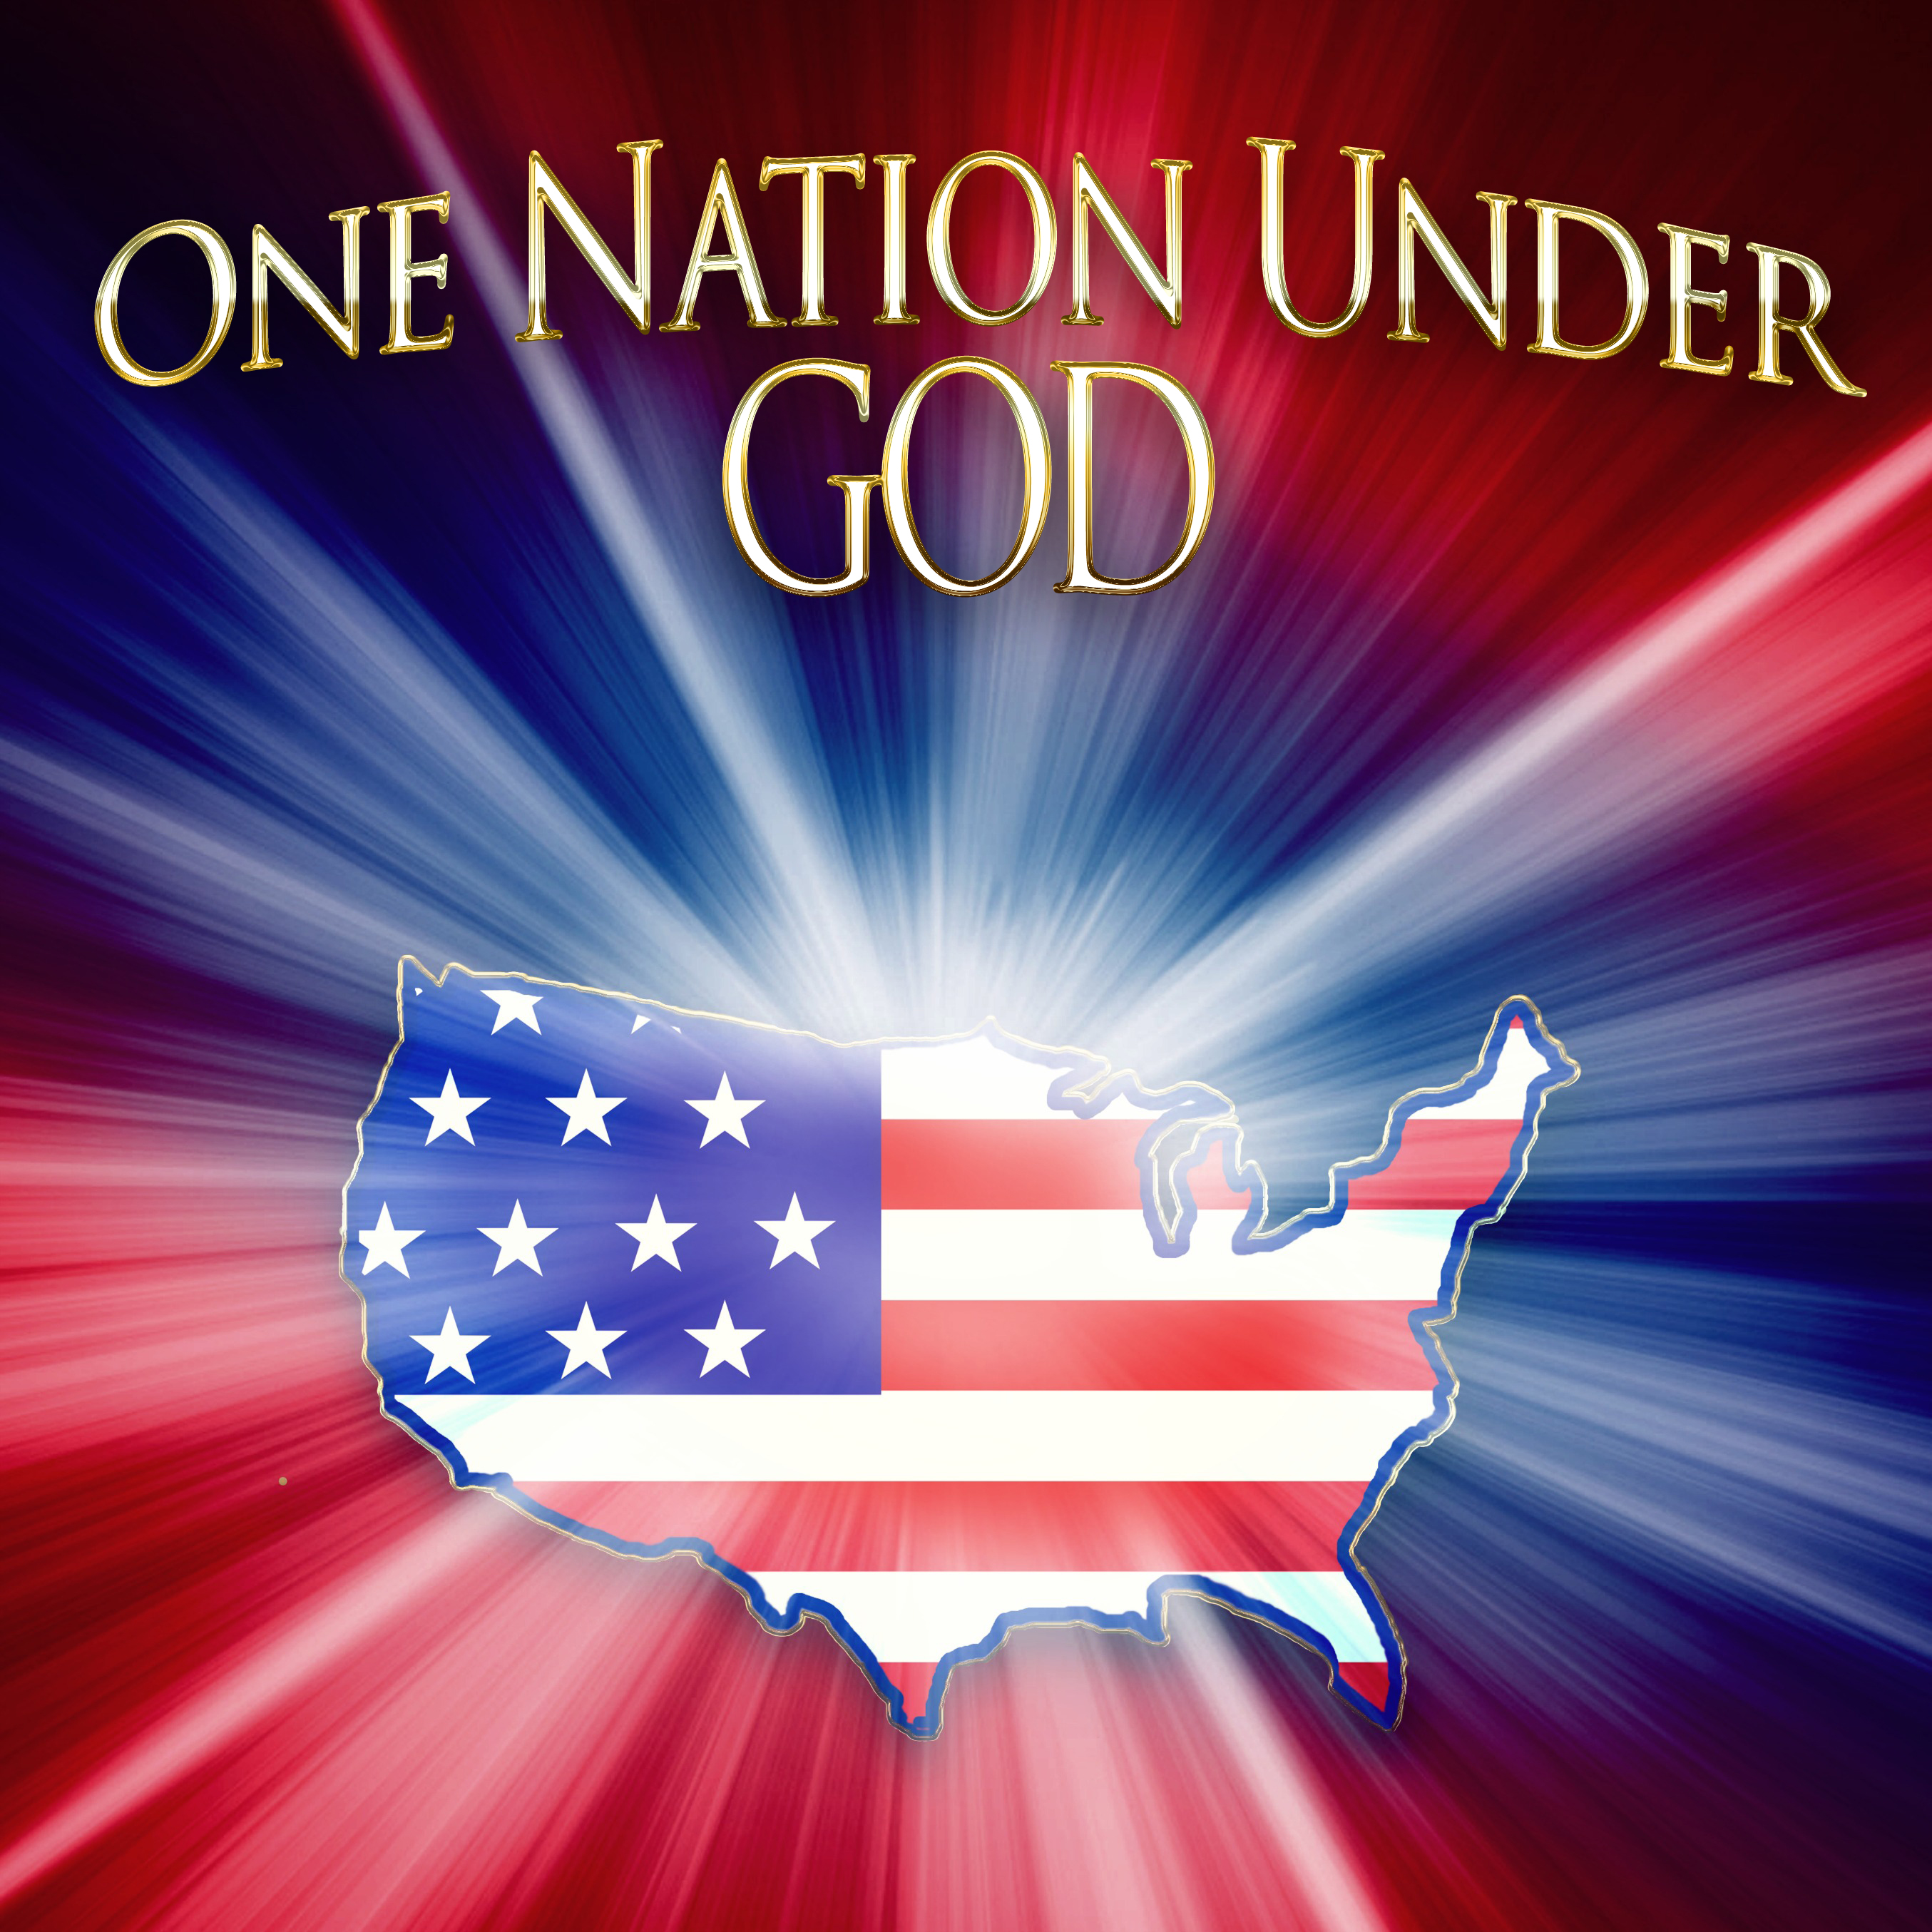
AMERICA A Nation Founded on Christian Values

Slide 26
AMERICA - A NATION GONE ASTRAY
America certainly appears to be the home of the harlot woman who is the guiding source of the beast in this era.
In today’s America, the voice of demons sounds quite pleasant.
These are voices that speak to us about living a happy and successful life but in reality, they conceal the truth that leads to true eternal happiness.

Slide 27
AMERICA - A NATION GONE ASTRAY
Prayer and Bible study outlawed in schools
A corrupt news media has brainwashed many of today’s Americans
Abortion clinics have butchered tens of millions of innocent babies & secretly sell their body parts.
Today’s American judicial system offer criminals have more rights than victims
Violent & demonic TV, movies, video games coupled with drugs has spawned a rebellious youth culture.
A “godless lifestyle” that welcomes adultery, abortion, pornography, homosexuality, and same-sex marriages as a normal way of life.

Slide 28
AMERICA - A NATION GONE ASTRAY
Sin and lawlessness have replaced righteousness and justice in our once great and mighty land.
Power and riches has led a former nation of God into a great apostasy.
The great prosperity experienced in this nation has lulled many of God’s people into following cross-less, painless gospel.
Sadly, our nation no longer worships the Lord who blessed us with prosperity and established our religious freedoms.

Slide 29
AMERICA - A NATION GONE ASTRAY
Godlessness in the Last Days
But understand this, that in the last days there will come times of difficulty. For people will be lovers of self, lovers of money, proud, arrogant, abusive, disobedient to their parents, ungrateful, unholy, heartless, unappeasable, slanderous, without self-control, brutal, not loving good, treacherous, reckless, swollen with conceit, lovers of pleasure rather than lovers of God, having the appearance of godliness, but denying its power. Avoid such people. 2 Timothy 3:1-5

Slide 30
AMERICA - A NATION GONE ASTRAY
Today, we are no longer the United States of America – we are now the Divided States of America.
Is modern America, together with those great historical empires, represented by Mystery Babylon who rides and steers the beast? PROBABLY!
At any rate, there can be no doubt that our country loves to fornicate with the lady who rides the beast.

Slide 31
AMERICA - A NATION GONE ASTRAY
Today, the United States is the only nation with the characteristics of Mystery Babylon to the level reflected in Revelation.
In this generation, the spirit of the whore is most prominent in the great cities of America.
Our once proud and mighty nation is shortly heading for a great and terrible fall.

Slide 32
THE BABYLONIAN WHORE AND “FALSE CHRISTIANITY”
A woman in Scripture is frequently symbolic of the God’s people.
In the OT; Israel is the Wife of Yahweh
In the NT; the church is the Bride of Christ.
In Scripture a spiritual harlot is one who claims to be faithful to her Husband; yet runs after the gods of other religions.
The spiritual harlot in America will help blend Christianity with other faiths and continue to dilute the true gospel of Jesus Christ.

Slide 33
THE BABYLONIAN WHORE AND “FALSE CHRISTIANITY”
Counterfeit churches in America also claim to be the true church!
She enjoys their favor as they bless her with precious jewels and gold.
Her churches are filled with false teachings that are designed to support her adulterous lifestyle and provide assurance that she is loved of God.

Slide 34
THE BABYLONIAN WHORE AND “FALSE CHRISTIANITY”
Her preaching of “tolerance” will be communicated as the ultimate expression of love.
She will side with governmental authorities who insist that the church must be “tolerant” of those who believe that there are many ways to eternal life.
She will help blend Christianity with other faiths and continue to dilute the true gospel of Jesus Christ.

Slide 35
BIBLICAL DOCTRINES REPLACED BY IDOLATRY
Today in America, numerous congregations avoid the preaching of the cross and the discipline of the Lord.
For the time is coming when people will not endure sound teaching, but having itching ears they will accumulate for themselves teachers to suit their own passions, and will turn away from listening to the truth and wander off into myths. 2 Timothy 4:3-5
These churches remain virtually silent concerning the sin that is rapidly overtaking our nation.
Everything is about to change. You will not recognize this nation in the very near future.

Slide 36
MY PEOPLE COME OUT OF BABYLON
The call to come out of Babylon is heard seven times, the last being in this chapter of Revelation.
This call implies that the way is open for people to depart from her.
It is a call to depart from the idolatrous pleasures of the world and turn to serving in the army of our Lord Jesus Christ throughout our lifetime.

Slide 37
MY PEOPLE COME OUT OF BABYLON
Who are the Christians who are in Mystery Babylon?
If you are in a church that does not proclaim the following foundational truths ------ COME OUT NOW!
Jesus Christ is God’s Son who came to earth to pay the penalty of death for all those who believe on His Name.
Jesus Christ is truly divine and existed from all eternity as the Son of God. He is the Word of God that was present when creation was spoken into being.
Jesus Christ is the one and only way to eternal salvation. There is no other way. You must be “Born again!”

Slide 38
COME OUT NOW!
IF YOU ARE IN A CHURCH THAT:
Compromises the truth that the Bible is not inerrant –
Teaches that “tolerance” expresses true love –
Teaches that the God of Christianity is the same as all other gods in different cultures –
Teaches that financial prosperity is available if we will only tithe to church ministry –
Where comforts have replaced the Cross in your life
Where Christians are ridiculed who will not deny their faith that Jesus is the only path to eternal life –
Then you are in Mystery Babylon. Come out now!

Slide 39
“ABOUT FACE”
This is a command used by our Commander-in-Chief , Jesus Christ, who calls us to “turn” from our sins.
What will Christians do when our Commander-in-Chief commands us to “ABOUT-FACE?”
Will they listen to some church leaders who tell them that the Commander-in-Chief really meant “RIGHT-FACE?”
Other false teachers may convince them that the command was really “AT-EASE”
Eventually the time comes when the Commander-in-Chief gives the command “FORWARD MARCH”
Those who heard and obeyed the command “ABOUT-FACE” will be equipped to follow the King of kings and the Lord of lords in the direction He is heading.

Slide 40
COME OUT OF BABYLON - NOW!
If Jesus Christ of Scripture be the true Savior, then surrender to Him.
But if the false Christ being commonly preached in many pulpits is your savior, then go ahead and follow him.
One who demands the denying of self and another who allows the gratifying of self cannot both be right.
One who insists on separation from the world and another who permits you to enjoy its friendship cannot both be right.
God will not accept a divided heart; He will have all or none. He will permit no compromise.
Come out now!

Slide 41
THE NEXT SESSION WILL ADDRESS:
THE LAST HARVEST
FOLLOWEDBY DESTRUCTION
Blessings & Warning in Seven Major Events
1 - The Lamb & 144,000 on Mt. Zion
2 – The Angel & the Everlasting Gospel
3 – The Fall of Babylon
4 – Warning Against “Worshipping the Beast”
5 – Blessed are Those Who Die in the Lord
6 – The Harvest of the Earth
7 – God’s Wrath Falling on the World of Evil
The Final Judgments Begin - Bowls of Wrath
First Read: --- Revelation 15-15 plus 16:1-9

Slide 42
Workbooks Available!
Workbooks & Power-Points may be downloaded for each session which can be used for teaching small groups!
My book “GOD’S ANOINTED WARRIORS” is also available at:
www.ecwatchmen.com

Slide 43
WWW:ECWATCHMEN.COM

